Slide 1



FinTech@HKUST
NEWSLETTER
2019 | JANUARY | #2
Editorial
“Why today’s MBA graduates need to learn about
both Business and Technology”
« Happy new year 2019!
This January 2019, the first HKUST MBA FinTech Club is already 6 months years old. In view of the progress made, we want to express our deepest greetings to the Business School, people and companies with whom we have had the chance to interact since our inception.
The club activity is part of a global trend: an increasingly interaction between business and technology.
HKUST MBA FinTech Club team
Learning the latest technology trends helps to make the best decisions for what that ideal future might look like” (Phillip Bonarigo).
Traditional MBA programs are failing to keep up with technological disruptions in business. Rapid advancements within technology mean there’s a challenge for recruiters to find young graduate talent who have the expertise and skillset to straddle the worlds of both business and technology. HKUST’s MBA students are aware of technology and how it can affect not just their learning experience, but also their futures.
Being able to showcase an in-depth know-how for business technology can have a tremendous impact on future careers for MBA graduates. MBA graduates are beginning to play a pivotal role in the tech industry, as HKUST’s latest graduate employment figures illustrate that 17 percent of its MBA graduates found employment in the IT and technology industry.
HKUST places a strong emphasis on providing students with real hands-on experience and learning opportunities. The HKUST MBA FinTech Club was launched as an initiative driver to encourage and strengthen students’ knowledge and expertise of FinTech. In this Newsletter we will present the coming electives courses related to FinTech, and the next club events and activities.
We wish you all an amazing year 2019!
FinTech Club Team
Agenda
Blockchain Competition
Page 2
Upcoming events
Startups Summit
Hong Kong & Shanghai Jan.26th
Helix Accelerator Kick-off (Mind Fund)
Consensys Competition
Hong Kong & New York
Jan.30th
Education Session Page 2
Company presentation Startup Mentoring
Page 3 Page 3
FinTech Career Treck
FinTech Events
– Hong Kong
Feb.02th
Page 4
MBA FinTech Electives Page 6
Page 5
FinTech Knowledge Page 6 & 7
confidentiel | © WAVESTONE
1

Slide 2

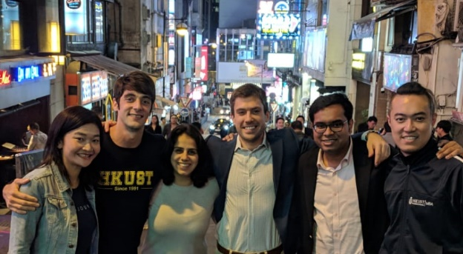
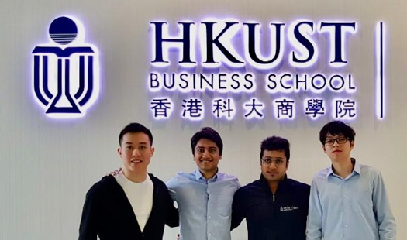

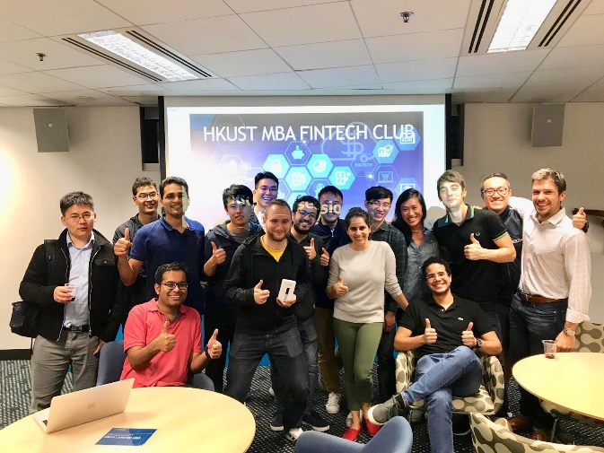

Blockchain competition - ConsenSys 2019 - Next round!
TWO PARTICIPATING TEAMS FROM HKUST BUSINESS SCHOOL MBA
In the first newsletter, we introduced you to the ConsenSys MBA Venture Competition where top MBA students from around the world from schools such as Harvard, Insead, LBS, and of course, HKUST compete to develop an application on the Ethereum blockchain.
COMPETITION DETAILS
HKUST has not just 1 but 2 teams participating in the 2019 ConsenSys MBA Venture Competition
The teams are working on approaches to solving the supply chain for diamonds and a method for expense reimbursements on the blockchain
Mentors for the teams include:
Donnie Benjamin: Region Lead @ ConsenSys. Former US Army Intelligence Officer, former Chief of Staff Joe Lubin, MBA, Harvard Business School
Joe Vander Zanden: Global Alliances & Business Development @ ConsenSys, ex-Cisco, PayPal
BCW Group: Hong Kong-based advisory firm specializing in blockchain and cryptocurrency services
Next Steps: Pitch Deck and related technical details to be submitted for review by ConsenSys before January 31st
Diamond supply chain project includes FinTech Club members Bhomik Jain, Sahil Wadhwa, Jonathan Prayoga and KC Luk
Expense management & reimbursement project includes members Phillip Bonarigo, Julien Hamonic, FiFi Lu, Puranjay Mahapatra, Deepika Solanki, and Daniel Tsai
The HKUST teams
Fifi Lu, Julien Hamonic, Deepika Solanki, Phillip Bonarigo Puranjay Mahapatra, Daniel Tsai
Jonathan Prayoga, Bhomik Jain, Sahil Wadhwa KC Luk (Bsc in Risk Management)
FinTech club first Education Session
CONTENT: Blockchain technology fundamentals, uses cases and ecosystem
DESCRIPTION
A great success! FinTech Club in collaboration with Genesis Block Hong Kong held it’s first Knowledge Sharing session in HKUST MBA Lounge on 06.12.18 with student keynote around FinTech HK ecosystem, cryptocurrencies fundamentals, Token offerings and Distributed Ledger uses cases
KEY SUBJECTS
HKUST FinTech Club first Education Session presented to the MBA cohort the latest applications regarding Blockchain Technology.
Subjects covered and speakers:
HK FinTech Ecosystem – P. Mahapatra
Cryptocurrencies - Phillip Bonarigo
Economics & DLT uses cases – J. Hamonic
Please find our full Presentation Support here
The event was sponsored by Genesis Block Hong Kong - A special thanks to them for sponsoring a Ledger Nano S!
FinTech Education Presentation
More about our sponsor Genesis Block, Hong Kong’s premier OTC trading centre and Bitcoin ATM provider: https://genesisblockhk.com/
2

Slide 3

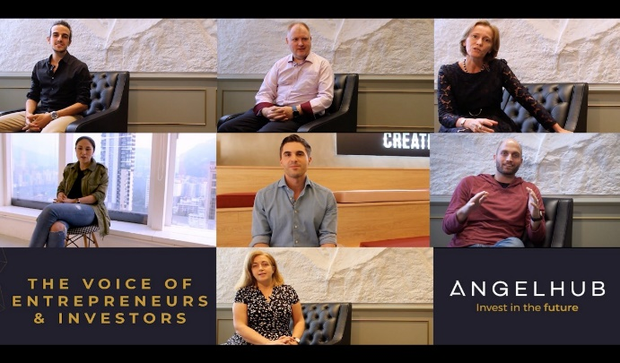




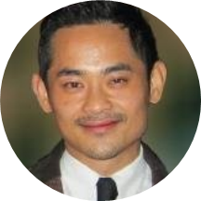



Company Presentation: AngelHub.io
FOCUS ON ANGELHUB - HONG-KONG & EQUITY CROWDFUNDING
3 months ago FinTech Club assisted to AngelHub.io in Hong Kong, the first Hong Kong regulated Equity Crowdfunding Platform, for Start-ups investment and financing
ANGELHUB LAUNCH! Oct.29, 2018
Having work with Whub regarding the Hong Kong Startup Ecosystem White Paper 2018 (download here: https://www.whub.io/toolbox) FinTech Club had the chance to be invited by Karen Contet Farzam, Co-Founder & CEO to AngelHub Pre-launch event at the Hong Kong Stock Exchange on Oct. 29, 2018. The event was a momentous occasion for WHub, HK’s startups and key stakeholders of the ecosystem
We are very grateful for this invitation!
VIDEO: ANGELHUB PRESENTATION
DEMOCRATIZING START UP INVESTMENT
FOLLOW THE FOUNDERS
AngelHub is the first regulated Startup Investment platform, using Crowdfunding Equity. It provides access, time and know how to startups and Professional Investors to democratize the fundraising process, combining the professionalism of VCs and the flexibility of Angel investing
Read “Democratizing Startup Investment” by Karen Contet Farzam to learn about how AngelHub will revolutionized how startups and investors interact
Karen Contet Farzam
Founder & CEO
AngelHub
Karena Belin
Founder & COO/CFO
AngelHub
Startups Mentoring with Helix Applications
Venture Capital experience for HKUST MBA Students in partnership with Mind Funds
WHAT IS IT ? Details of the Mentoring Program
Helix Accelerator is a coworking space run by Mark Cheng in Hong Kong within Mind Fund, a venture capital company
Mind Fund partnered with Hedera Hashgraph, a new blockchain protocol (www.hedera.com)
Together, Hedera and Mind Fund established Helix, a startups accelerator program in Hong Kong, dedicated to the companies building solutions on the Hedera Hashgraph blockchain
More than 10 startups has been chosen to be incubated through Hedera Global Hackathon
HKUST MBA FinTech club will provide to Helix mentorship support for Hedera developers
Helix Applications will held its first startups cohort from 11 February to 22 April 2019
Program details:
Hong Kong based (Aberdeen) 10-weeks program
10 companies per cohort
All teams must build on top of Hedera Hashgraph protocol
Mentorship and advisory provided
All teams to receive USD 100K upon graduation
Startup blockchain solutions for: Trade Finance, Supply Chain, Micropayments, Name Service, Music Streaming, or Insurance
Mark
CHENG
CEO @ Helix
More about Hedera Hashgraph and the first selected startups: https://www.prnewswire.com/news-releases/hedera-hashgraph-announces-winners-of-global-hackathon-and-hedera-mvps-300733328.html
confidentiel | © WAVESTONE
3

Slide 4
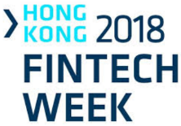
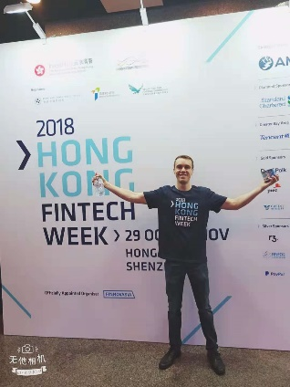
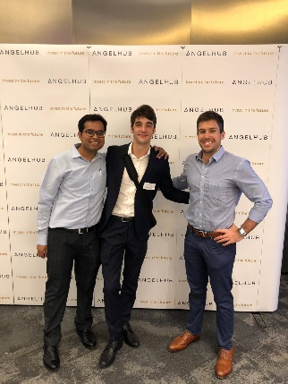
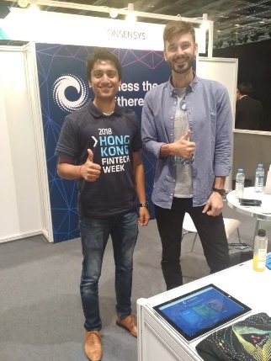




Focus on Event: Hong Kong FinTech Week 2018
HONG KONG FINTECH WEEK
OCTOBER 29 – NOVEMBER 02 2018 / HONG KONG
CONTEXT
KEY-ELEMENTS
FinTech Week 2018 was the world's first cross-border financial technology event, that took place in Hong Kong, Asia's financial capital, and in Shenzhen, China's Silicon Valley.
It's one of the largest conferences on the calendar, attracting more than 8000 senior executives and featuring over 200 of the world's top FinTech founders, investors, regulators, and academics, who are shaping the future of financial services by driving a technological revolution in the industry across Asia and globally.
MBA Career Service and HKUST FinTech connected with Finnovasia, Organizer of HK FinTech week
Our MBA FinTech Club members have been happy to:
Interns for FinTech week planning & preparation!
Volunteers for on-site organization!
Amongst numerous FinTech and blockchain start ups and companies, fruitful insights had been exchanged with Top Tier consulting firms deeply involved in the ecosystem including :
Deloitte Hong Kong Blockchain Lab, Accenture, EY, PWC…
8000+
participants
Top FinTech founders, investors, regulators, and academics
2
Locations
Hong Kong, Shenzen
Global Attendees
+50 countries
KEY TOPICS AND ANNOUNCEMENTS
Open API (Application Programming Interface) is changing the landscape of banking sector around the world by accelerating the rise of virtual banks and neobanks
HKMA Open API expects to complete by mid-2019; HKMA has already received 29 applications for virtual banking licenses, including several technology and mobile wallet companies.
Payment/ Mobile Wallets development in HK & Asia
Mynt payment has collaborated with Ant Financial to implement eWallet remittance on blockchain - zero transaction fees can be offered to customer for instant transfer
SFC Regulation of Crypto Exchanges and Funds:
A major announcement! Ashley Alder chief of HK Securities and Futures Commission announced a series of steps that would culminate in a formal regulatory environment
See statement here: https://www.sfc.hk/web/EN/news-and-announcements/policy-statements-and-announcements/reg-framework-virtual-asset-portfolios-managers-fund-distributors-trading-platform-operators.html
4

Slide 5
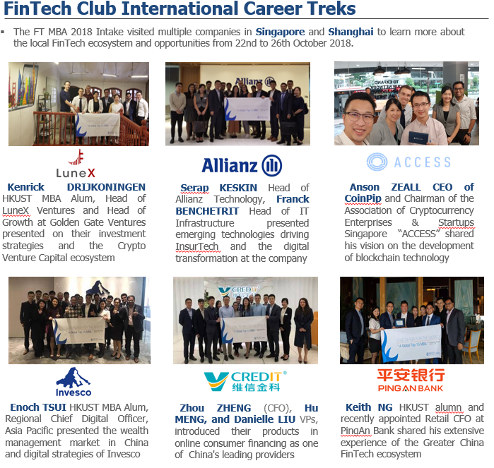
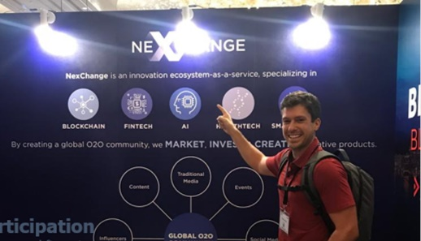

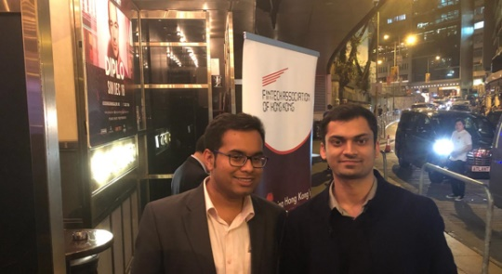

FinTech club members events participation
Example of events attented in an active Hong Kong and APAC FinTech scene in 2018
CONSENSUS SINGAPORE 2018
FINTECH ASSO. OF HONG KONG| 04.12.18
The event attracted +8000 attendees including members of HKUST Fintech!
75+ speakers across 2 days shared latest insights around blockchain & crypto markets
Thanks to Syed Musheer Ahmed - General Manager, FinTech Club had the chance to volunteer for of the FTAHK End of Year event
We whish the best to FTAHK in 2019!
FinTech Club team networking
@Consensus Singapore!
FinTech Club team
@FTAHK Event!
5

Slide 6
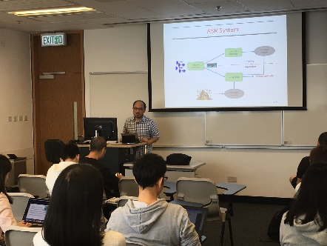
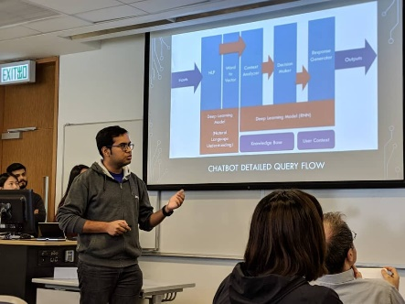

FinTech New Elective Courses
A LARGE OFFER OF NEW ELECTIVES CLASSES IN 2019!
MBA Curriculum is evolving
Technology, FinTech, and start-ups are hot topics in the market. This year, the MBA curriculum has been reformed to match the market trends and equip students with the latest knowledge and skills required in the evolving business world! Courses Offered include:
Financial Technology for Business Professionals: overview of FinTech used in the finance, banking and insurance industries, including the computing and digital technologies such as open source software, API’s, big data/IoT, AI, cloud computing, blockchain, etc., and how they are deployed in crowdfunding, crypto-currency, fast payment/remittance, algorithmic trading, wealth management, financial intelligence, etc.
Artificial Intelligence: For the first time, the course provided students with a core set of skills to understand, apply, and interpret AI concepts and technologies in various real-world applications, including computer vision, image processing, speech processing, natural language processing, and e-commerce.
Deep Learning Business Applications with Python: Python, an interpreted programming language widely used by developers around the world to create various applications, such as websites, machine learning algorithms, and automated task simplification, has become an important skill that business talents should acquire.
Cryptocurrency, Blockchain, and Their Business Applications: This unprecedented course will discuss cryptocurrencies (Bitcoin, Ethereum), blockchain, also referred to as distributed ledger technology (DLT), and their application in various business sectors, from the history of cryptocurrency and the fundamentals of blockchain including cryptography and consensus mechanism to real-world applications.
Prof. Brian MAK from Computer Science Dep. teaching the AI course
FinTech Club member
(P. MAHAPATRA) presenting an AI business proposal
10+
FinTech related electives!
FinTech Know How!
Applied Deep Learning- CHATBOTS
Banks have started using Chatbots to support customer interactions and speed up service for a while now. However, Chatbots have evolved from being a simple tool to answer FAQs to a full fledged digital assistant that can initiate conversations and give feedback based on both unstructured and structured data
Intelligent Chatbots are often powered by a Deep Learning Algorithm called Recurrent Neural Networks (RNN). RNNs are multi-layered neural networks that store information in context nodes, allowing them to learn data sequences in an iterative manner over time and output relevant data sequences as per the input query
Chatbots that can address more nuanced customer needs and queries will help reduce the occurrence of handover of queries to human agents and help increase the overall productivity of the organization
According to Gartner, Inc- ”Twenty-five percent of customer service and support operations will integrate chatbot technology across engagement channels by 2020, up from less than two percent in 2017”
Bank of America Erica AI Chatbot
6

Slide 7
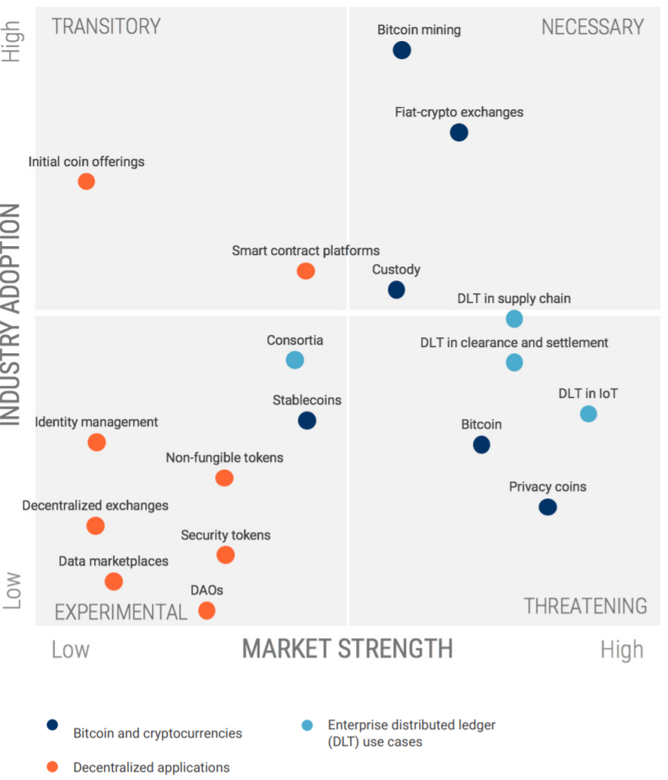
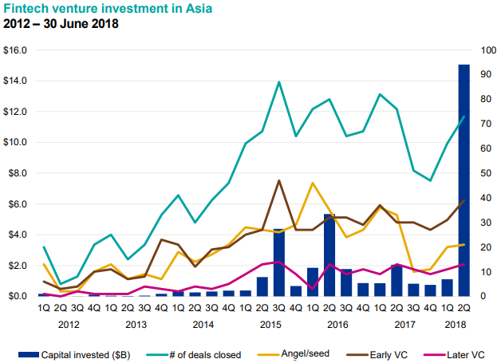
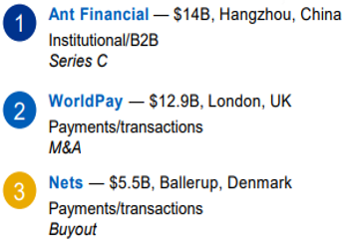
FinTech markets forecasts
WHAT’S NEXT FOR BLOCKCHAIN IN 2019?
CB Insights has brought an Emerging Trends in Blockchain Technology 2019 report that highlights the potential of different aspects surrounding the blockchain ecosystem
Experimental and Threatening Quadrants are still majors in the industry
Stablecoins have been gaining surging interest the past year
Two USD-backed stablecoins - Paxos Standard (PAX) and The Gemini Dollar (GUSD) became the world’s first regulated cryptocurrencies in September 2018 after approval from the New York State Department of Financial Services
Use cases are still to be found as consulting company McKinsey believes that there is little evidence of practical use for blockchain, according to a publication on Jan. 4.
Source: Blockchain Trends in 2019 https://www.cbinsights.com/research/report/blockchain-trends-2019/
Emerging trends in Blockchain technology
Venture Capital in FinTech
RECORD VENTURE CAPITAL DEALS IN FITECH SECTOR IN 2018
2018 witnessed an investment of US$57.9bn, across 875 deals. Highlights of investments were Artificial intelligence and Robotic Process Automation, while Insurtech and Regtech grew
2018 was the year of transformative regulations such as GDPR in Europe, and PSD2, making open banking a lucrative segment for investments
2019 is predicted to be driven by financial inclusion via mobile payments, blockchain, and open banking. Banks would focus on contactless payments. Smart contracts should catalyse the disruption in finance
GAFA, the big four tech companies: Google, Amazon, Facebook, and Apple, should enter retail banking space, having already obtained local banking licenses
2012-2018 FinTech VC investments
2018 major VC investments
Source: KPMG 2018 Pulse of Fintech report
7

Slide 8



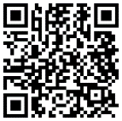

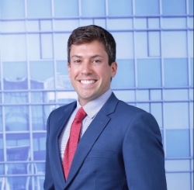

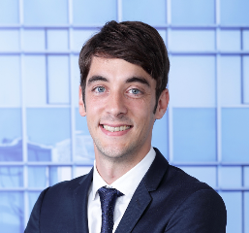
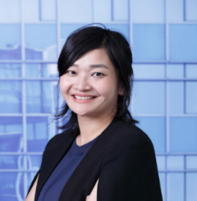
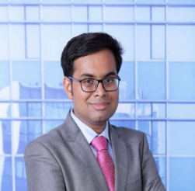


Slack Group
ACCESS TO OUR RESSOURCES ON SLACK !
Join our Slack Group for Knowledge Sharing!
https://ustftmba.slack.com/messages/CC81B4E5Q/
Recent Posts:
Blockchain what is it ?: https://www.khanacademy.org/economics-finance-domain/core-finance/money-and-banking/bitcoin/v/bitcoin-what-is-it_Vuv8J0
SEC Statement on Digital Assets Securities Issuance and Trading: https://www.sec.gov/news/public-statement/digital-asset-securites-issuuance-and-trading
Pitcbook 2019 Emerging Technology Outlook: https://ustftmba.slack.com/files/UBZ50S8TC/FF25YKASX/pitchbook_2019_emerging_technology_outlook.pdf.pdf
e/open-banking-cma-psd2-explained
Facebook Page
CONNECT ON FACEBOOK!
Join & Like Our Facebook Page!
https://www.facebook.com/FinTechHKUST/
WhatsApp Group
JOIN US ON WHATSAPP!
Join us for on our special WhatsApp Group!
https://chat.whatsapp.com/65DFeOTUG3f2hdm3fIgyGd
Instagram #Tag
SHARE ON INSTAGRAM!
Witnesses a FinTech or Blockchain event? Share your experience with us using the #FinTech@HKUST!
Meet the Editorial Team of FinTech@HKUST Newsletter!
Phillip BONARIGO
Editor
Vandana JAIN
Editor
Julien HAMONIC
Lead Editor
Fifi
LU
Editor
Puranjay MAHAPATRA
Editor

